Slide 1
NBA Analysis and Visualization
Zacharias Girmay | Spencer Hitchcock

Slide 2
Evolution of the 3-Point
Here https://public.tableau.com/profile/spencer.hitchcock#!/vizhome/3ptanalysis_15579536418970/Dashboard1?publish=yes

Slide 3
Grabbing the data
API Pull | Reflection of NBAstats.com
Data Scrape | basketball-reference.com

Slide 4
Machine Learning – Nearest Neighbor
This is a machine learning method which we used for classification
In our case. We want to know if we could classify a good year vs a bad year for NBA players.
Multivariate attributes are age, 3s made, 3s attempted, and 3 point average.
Turns out we can.

Slide 5
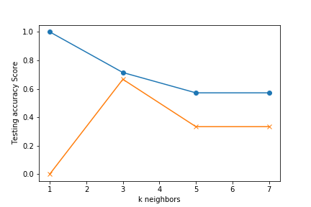
Steph Curry
K: 3 looks to be the best choice for this dataset.
k=3 Test Acc: 0.667

Slide 6
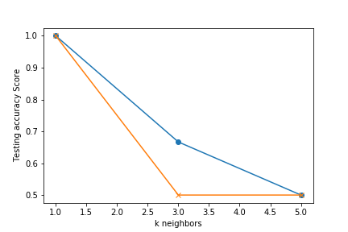
Ty Lawson
K: 1 and 5 look to be the best choices for this dataset.
k=1 Test Acc: 1.000
k=5 Test Acc: 1.000
Pretty solid accuracy.

Slide 7
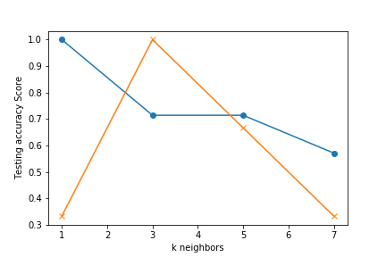
Darren Collison
K: 5 looks to be the best choice for this dataset.
k=5 Test Acc: 0.667

Slide 8
3-Point Analysis
https://public.tableau.com/profile/spencer.hitchcock#!/vizhome/3ptanalysis_15579536418970/Dashboard1?publish=yes

